Slide 1
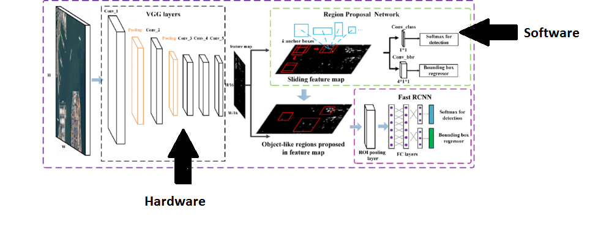
Block Diagram of the project

Slide 2
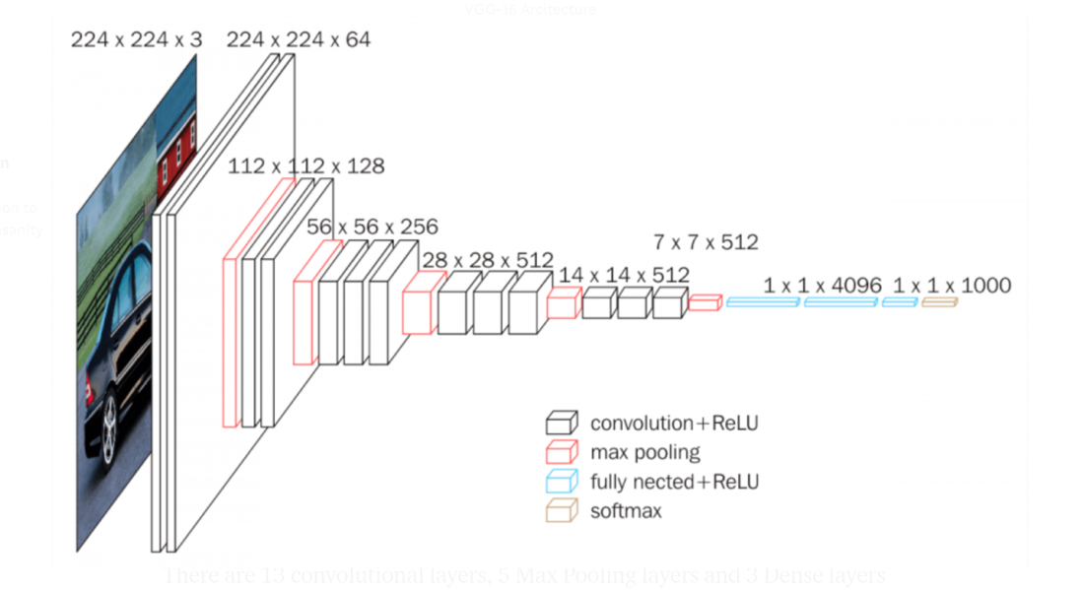
Hardware Implementation
Block diagram of layers of VGG-16
Figure 5

Slide 3
Convolution Layer

Slide 4
Convolution Layer
Inputs: Taking the input RGB image as three dimensional array with (channel * row * column ) and the kernels number , channels and size as four dimension array (kernel number, kernel channel , row , column)
Outputs:The feature maps the number of them is equal to the number of filters and the size is equal to image size –kernel size +1 if no padding is used
Github Code: Hardware-FasterRCNN/Hardware/HLS/Convolution

Slide 5
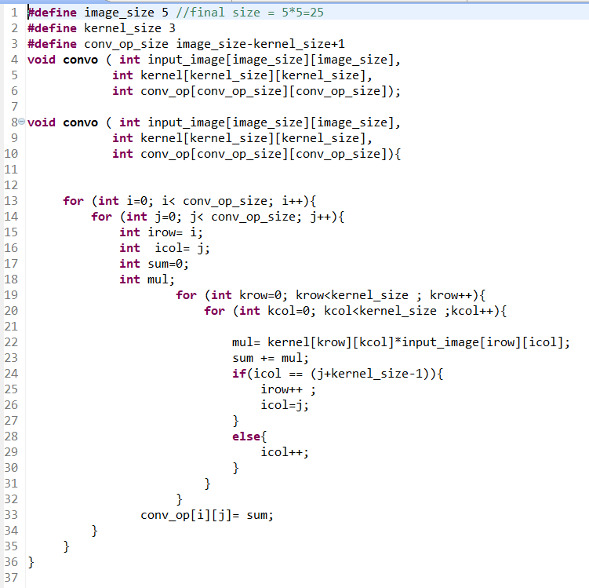
Code implemented

Slide 6
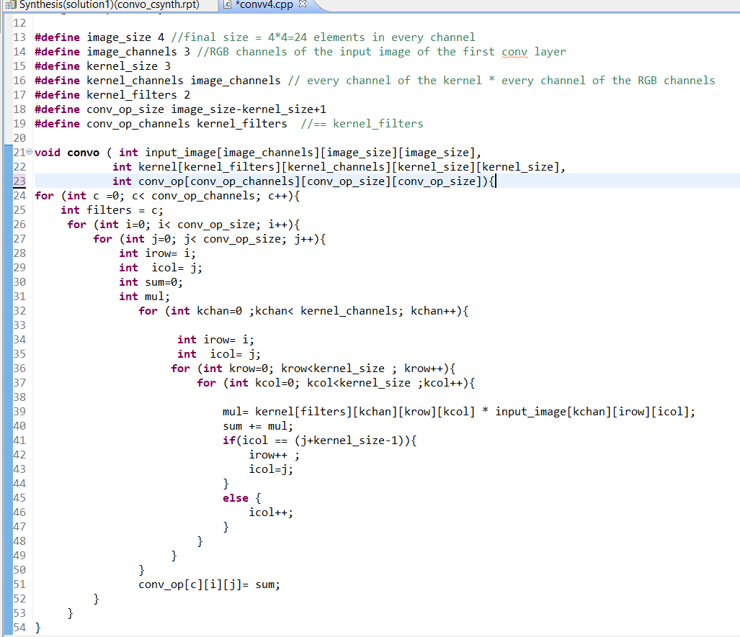
Convolution (RGB Input images and kernel channels)

Slide 7
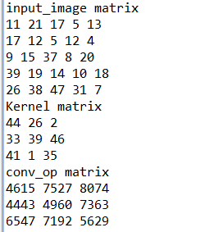
Software Results
Figure 15

Slide 8
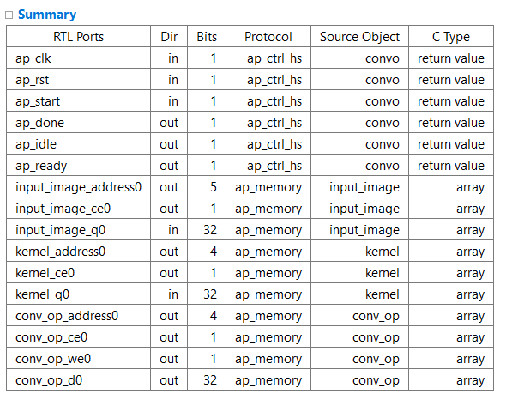
Synthesized code output report

Slide 9
Simulation results
The simulation shows that convolution process is carried out as intend in the c++ code and below output is output of c++ testbench and the output exactly the same. Noting that the we0 (write signal in the output memory (array)is high only when the correct result signals has arrived can be specified by the clock period during project )

Slide 10
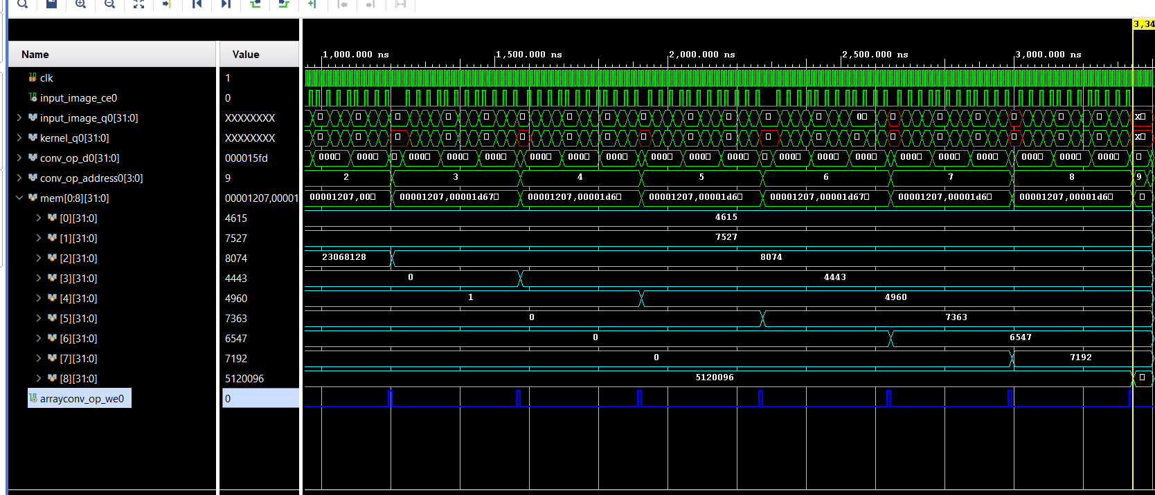

Slide 11
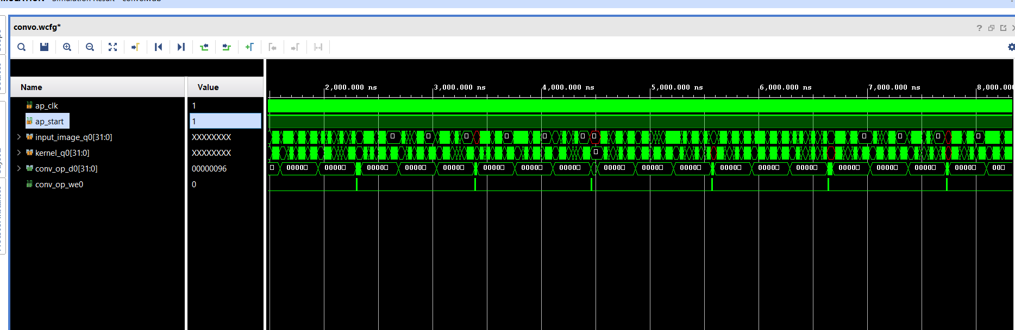
Simulation results (RGB Input images and kernel channels)

Slide 12
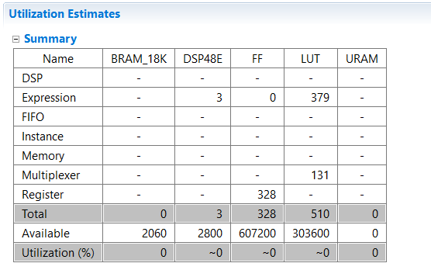
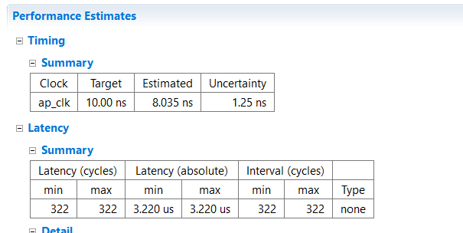
Performance metrics
Clustering

Slide 13
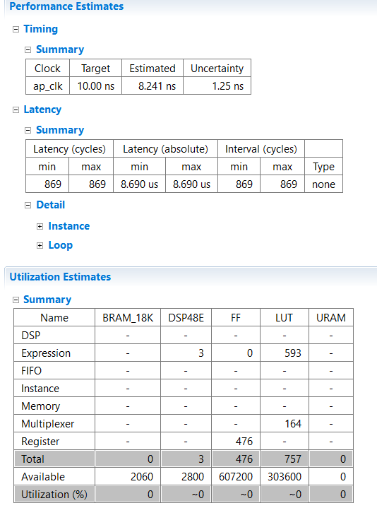
Performance metrics (RGB Input images and kernel channels)

Slide 14
Padding Layer

Slide 15
Padding Layer
Inputs: Input matrix of size 3x3
Outputs: Output matrix of size 5x5 of the 3x3 matrix surrounded by zeros
Github Code: Hardware-FasterRCNN/Hardware/HLS/Zero_padding/C++ codes

Slide 16
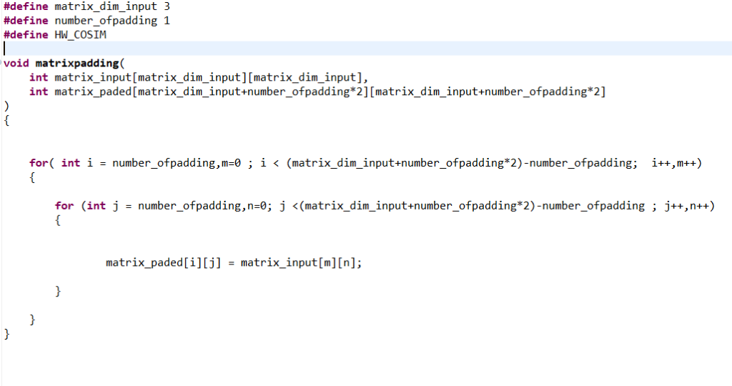
Code implemented

Slide 17
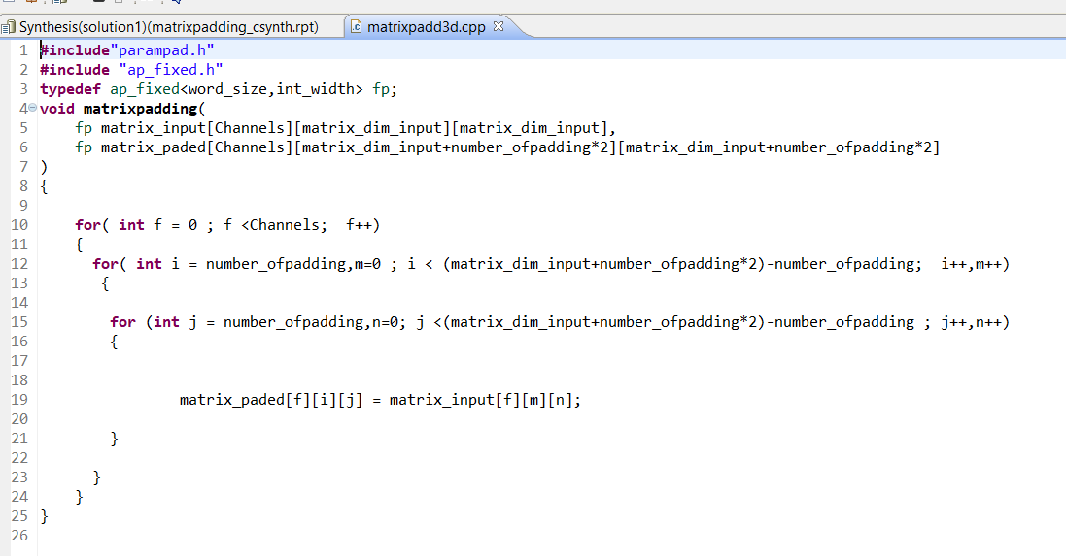
Padding ( padding image with multiple channels )

Slide 18
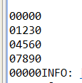
Software Results

Slide 19
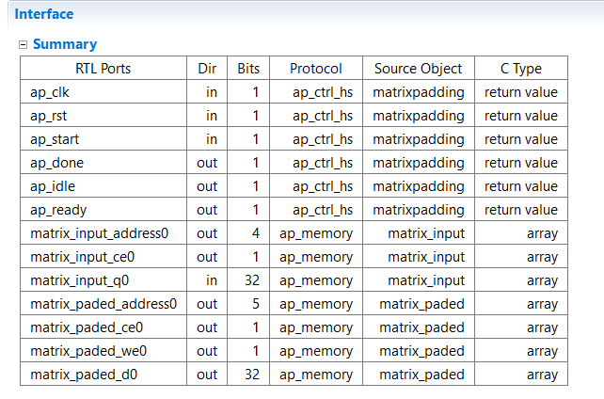
Synthesized code output report

Slide 20
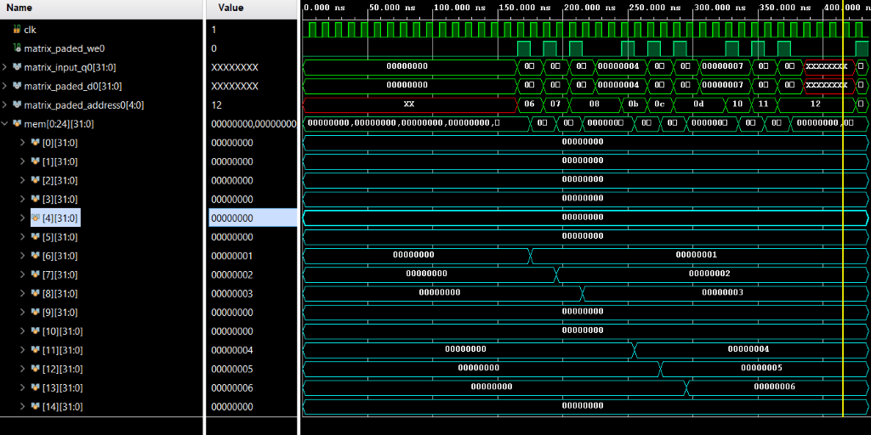
Simulation results

Slide 21
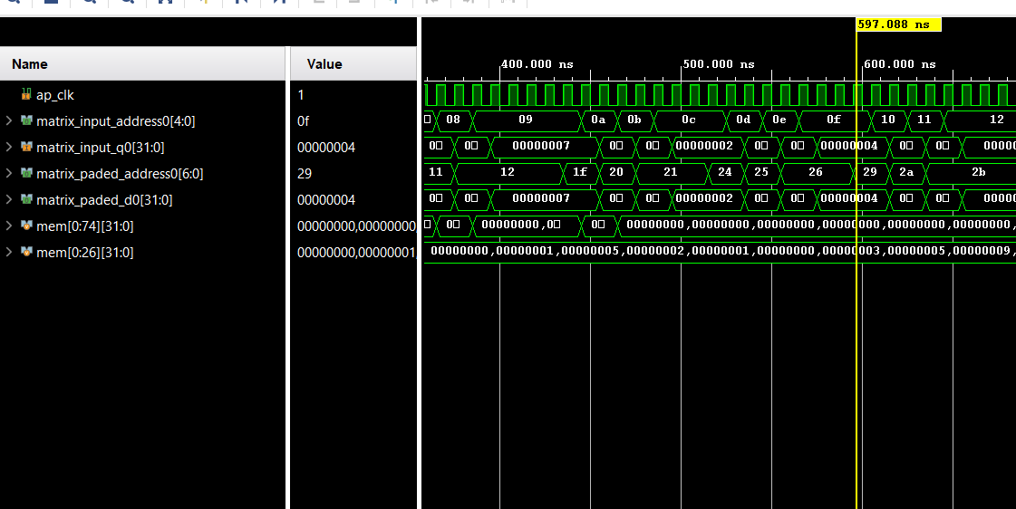
When the input is 3d Matrix (channels * columns*rows)

Slide 22
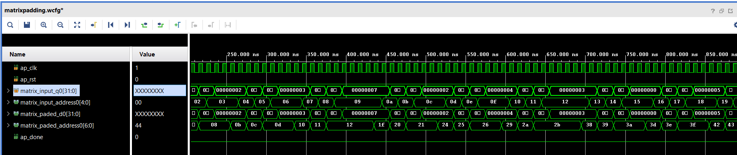
Padding ( padding image with multiple channels )

Slide 23
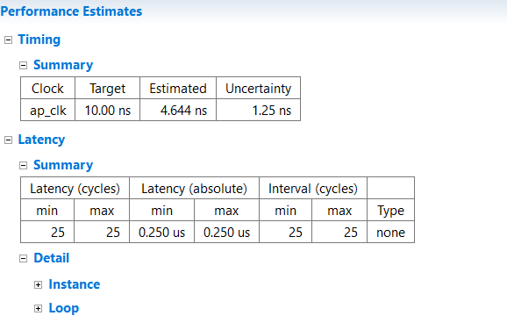
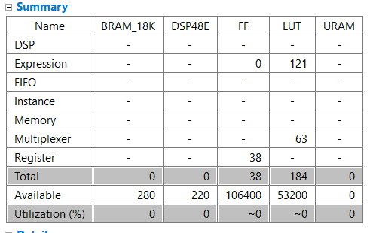
Performance metrics

Slide 24
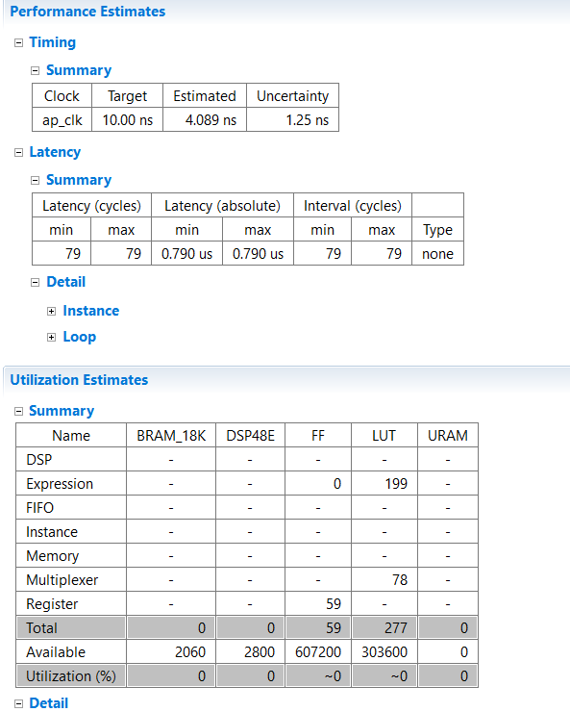
Padding ( padding image with multiple channels )

Slide 25
Max Pooling Layer

Slide 26
Max Pooling Layer
Inputs: Input matrix of 5x5
Outputs: Output matrix of 3x3 but with the maximum numbers only of the input
Github Code: Hardware-FasterRCNN/Hardware/HLS/max_pooling/C++ codes

Slide 27
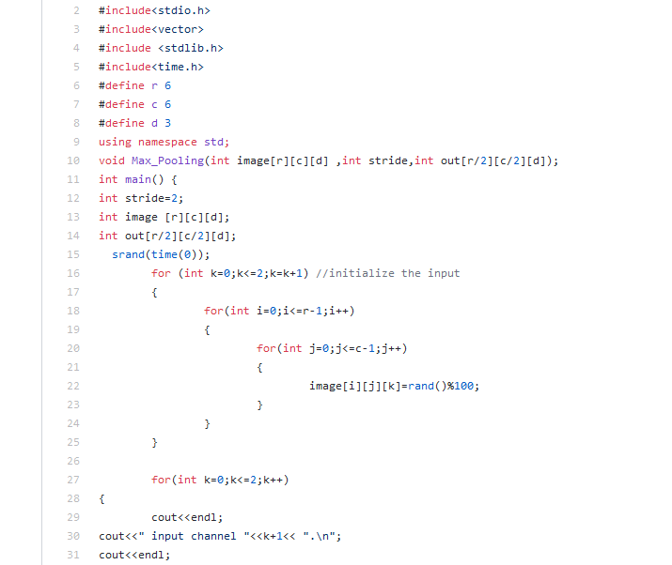
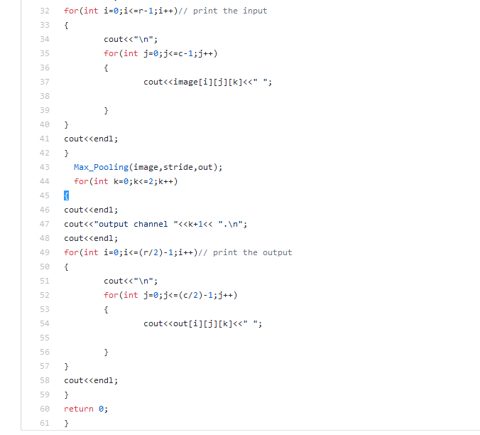
Code Implemented

Slide 28
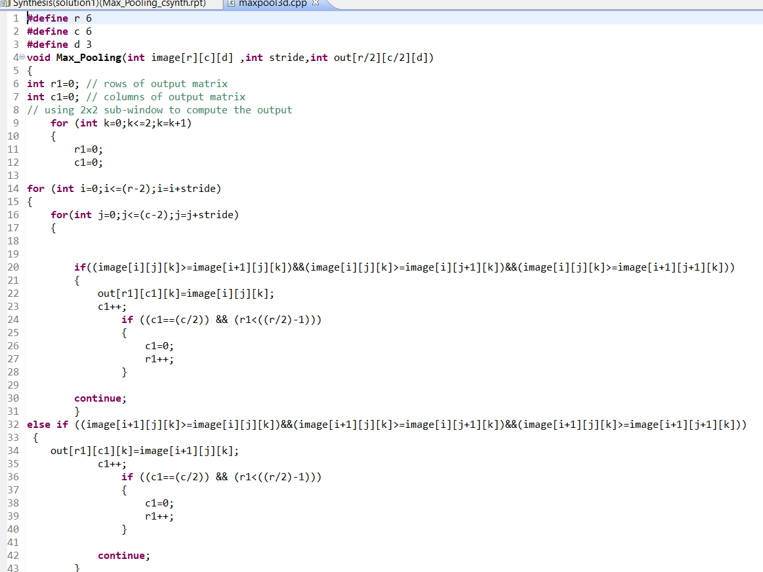
Max pooling (for multiple feature maps )

Slide 29
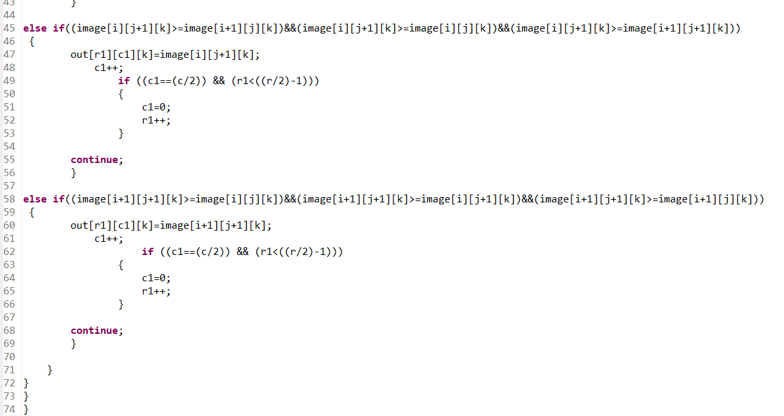

Slide 30
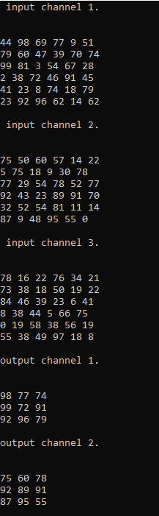
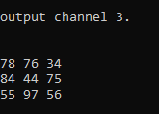
Software Results

Slide 31
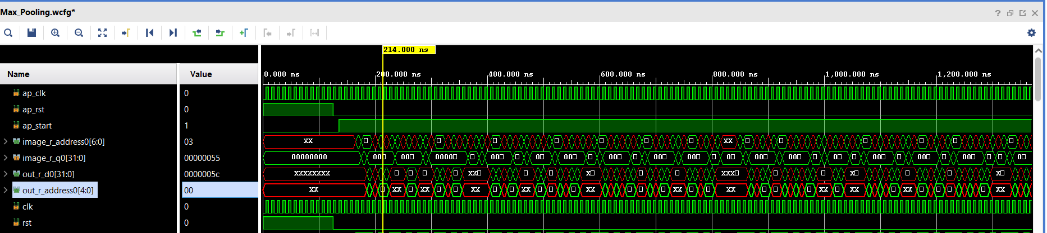
Simulation Results

Slide 32
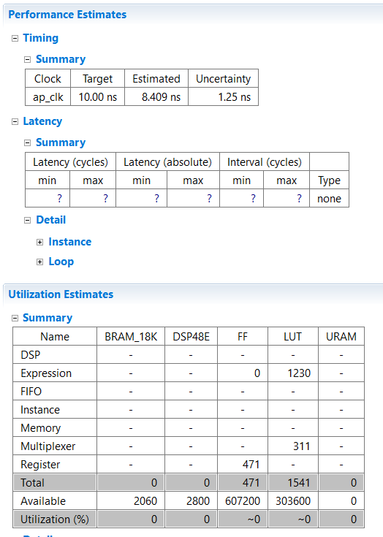
Performance metrics

Slide 33
ReLU

Slide 34
ReLU Layer
Inputs: Input matrix of defined size
Outputs: Output matrix of same defined size but output greater than zero only
Github Code: Hardware-FasterRCNN/Hardware/HLS/relu/C++ codes

Slide 35
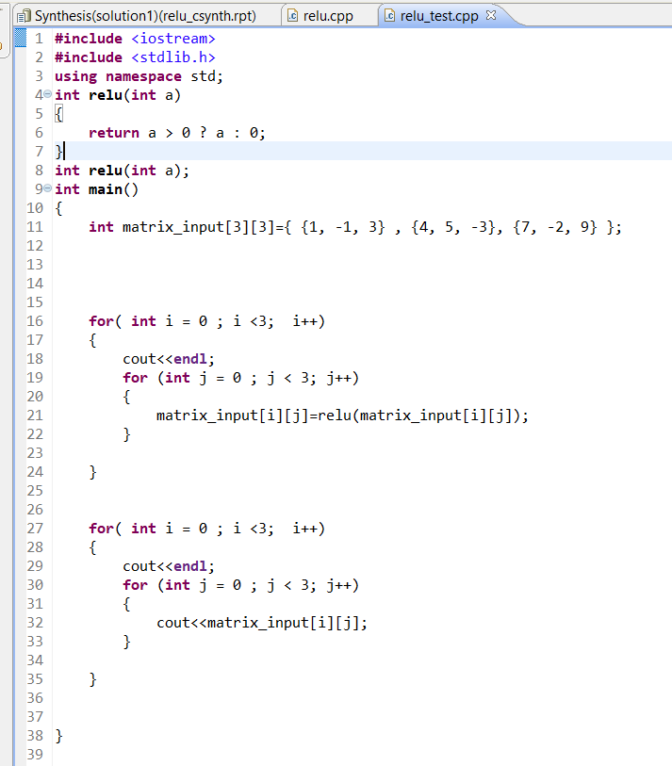
Code Implemented

Slide 36
Software Results

Slide 37
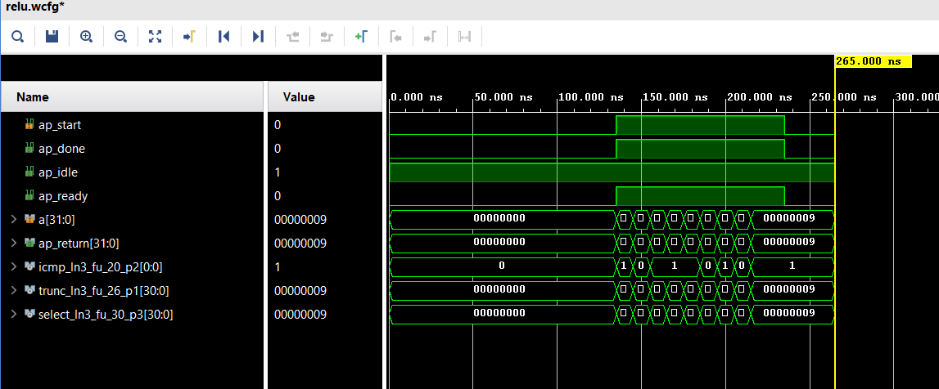
Simulation Results

Slide 38
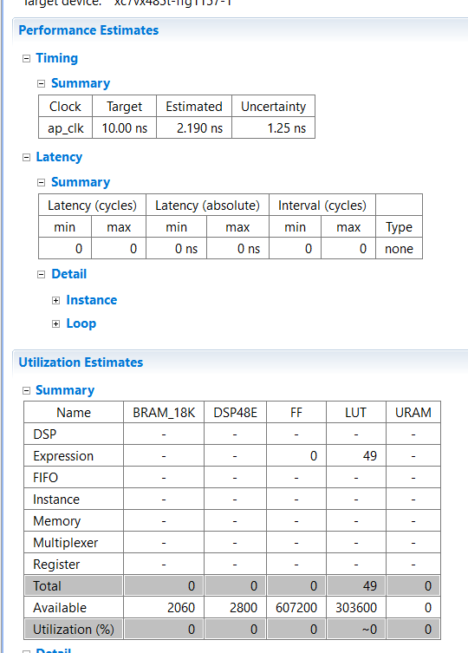
Performance metrics

Slide 39
Integration of padding and convolution

Slide 40
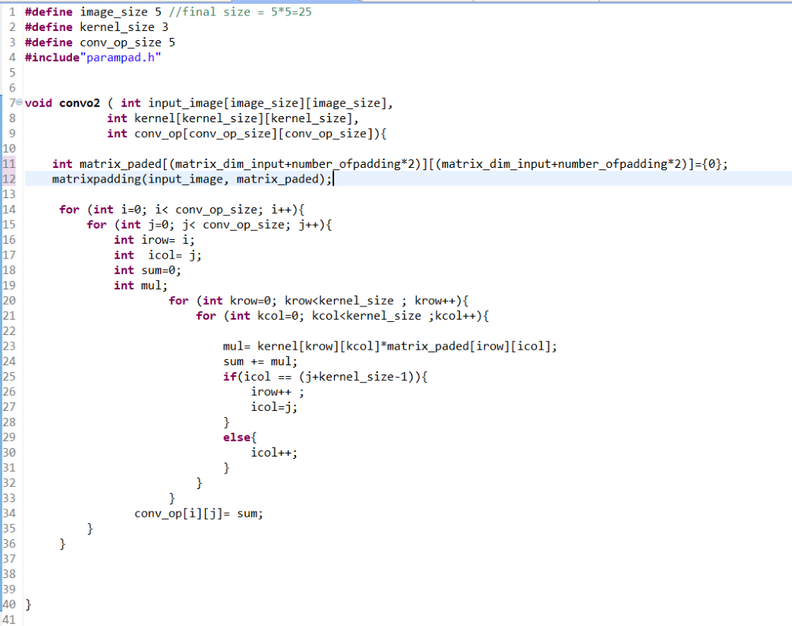
Integration of padding and convolution

Slide 41
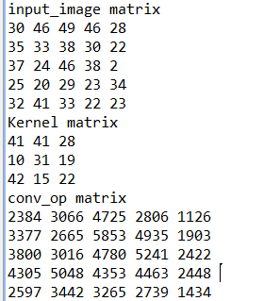
Software Results

Slide 42
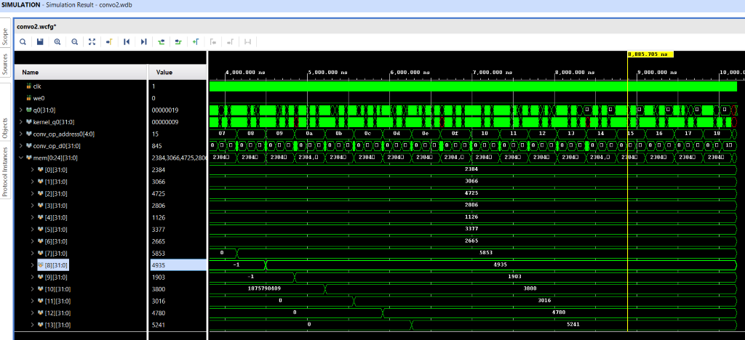
Simulation results

Slide 43
Integration of (Padding-Convolution-Maxpooling)

Slide 44
Integration of (Padding-Convolution-Maxpooling)
Start the function by padding the input image so the feature map after convolution is same size if input image
Then do the convolution with one image RGB ,2 filter with three channels each
Then do max pooling 2*2 which reduce the output feature map size by 2

Slide 45
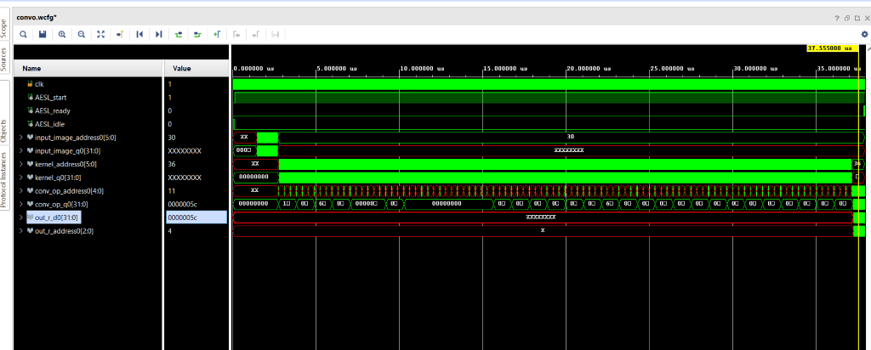
Simulation results

Slide 46
Block Diagram of the project

Slide 47
Software implementation
Simulated a full Faster-RCNN using the code in the following repo
Hardware-FasterRCNN/Software/tensorflow-object-detection-faster-rcnn/
The steps is attached to the readme file in the github code
https://github.com/Ramy-osama/Hardware-FasterRCNN

Slide 48
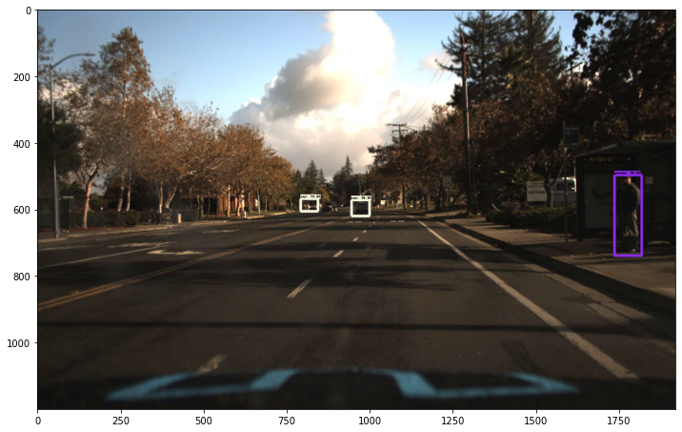
Results

Slide 49
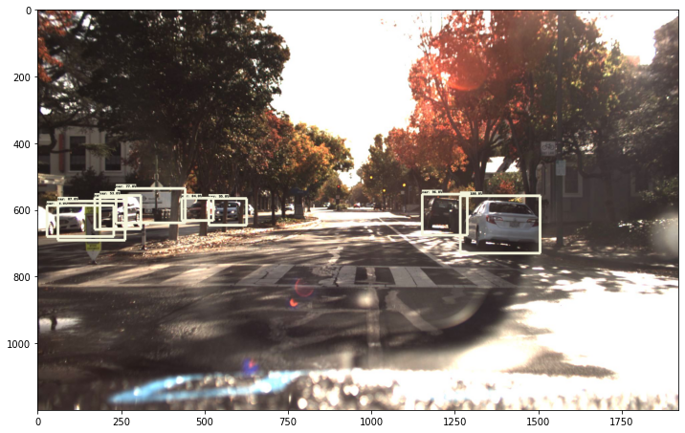
Results

Slide 50
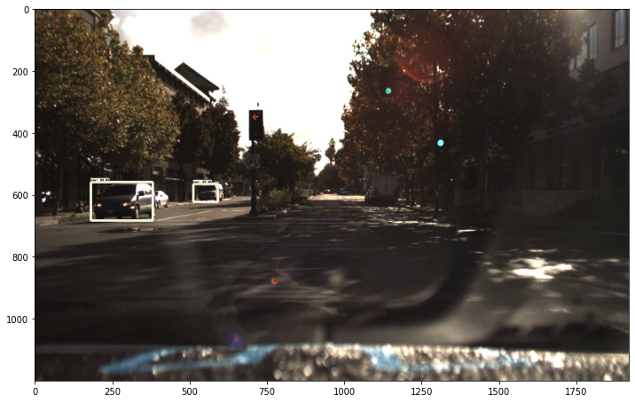
Results

Slide 51
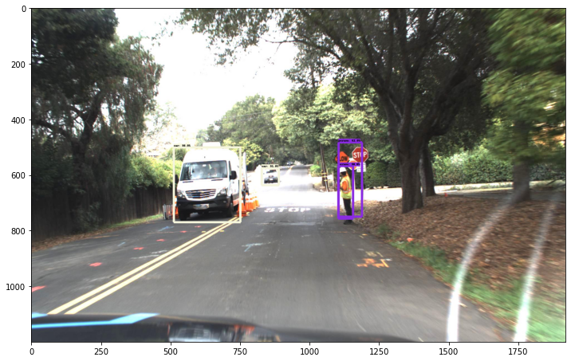
Results

Slide 52
VGG16
created 3 Vgg16 to do get weights we will use in the hardware simulation
1st VGG I took as a refence from the github code:
https://github.com/Ramy-osama/VGG16-In-Keras

Slide 53
VGG16_v1
Trained VGG16 on the fashion_mnist dataset built in TensorFlow

Slide 54
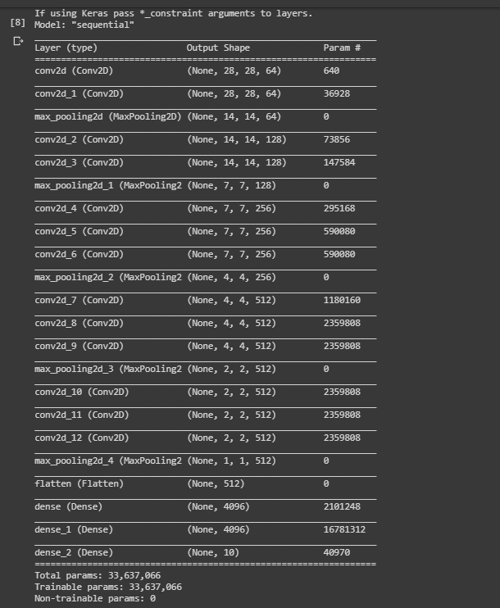
VGG16_v1 architechture

Slide 55
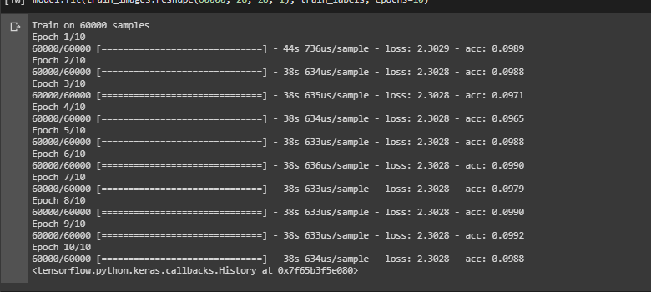
Vgg16_v1 result

Slide 56
Vgg16_V2
Removed some Layers as the size of the images is so small and there are many MaxPool layers That reduces the size of the image which makes it very hard for the network to train

Slide 57
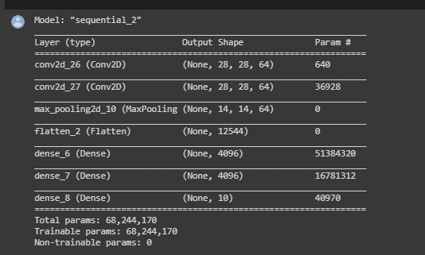
Vgg16_V2 architecture

Slide 58
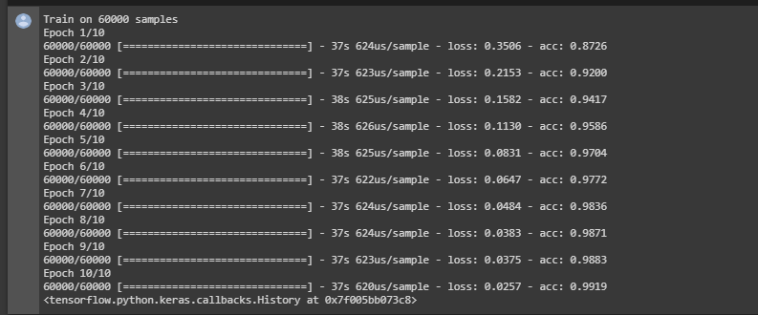
Vgg16_V2 results

Slide 59
Vgg16_V2
The weights were extracted in h5 file format and uploaded on a google drive

Slide 60
Future work
Read an image on c++ and apply the convolution layer on it
Use the extracted weights to build our model and use make sure it is working properly by using it in the inference mode
Train vgg16 on an autonomous car dataset which is our interest and extract its weights
Apply the extracted weights to complete Vgg16 architecture and use it in inference mode and make sure it is working properly

Slide 61
Thank You

